Slide 1

Retail Sales Prediction
M. Jagadeesh
221FA14057
Bioinformatics – 3A

Slide 2


contents
01 | Introduction
02 | Linear Regression Model
03 | Python code and it’s result
04 | R code and it’s result
05 | Conclusion

Slide 3

INTRODUCTION
To predict retail sales using a linear regression model in R, load the required libraries (`ggplot2}, {dplyr{, {caret}) and use `read.csv()` to read your dataset. Preprocess the data by choosing the pertinent columns ({Sales} and `Customers}) and using `na.omit()` to eliminate any missing entries. Utilizing `createDataPartition()}, divide the data into training and testing sets. Utilizing `lm()`, construct a linear regression model on the training data set and use the test set to generate predictions. Compute the Mean Squared Error (MSE) and R-squared to assess the model's performance. Lastly, the actual sales versus the total number of clients were plotted in a scatter plot, and the regression line was overlayed to see the results using ggplot2.

Slide 4
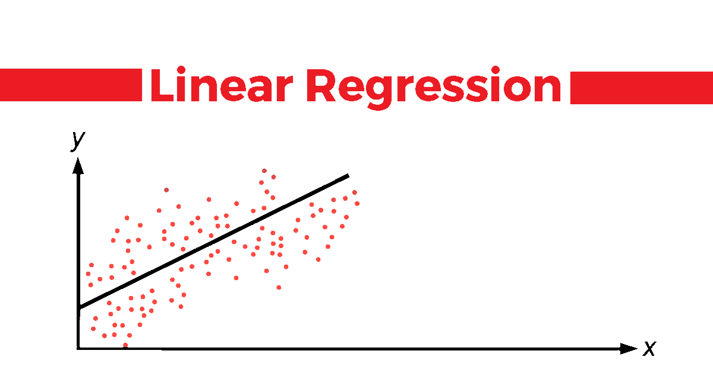
Linear Regression
Linear regression in machine learning using R involves predicting a continuous dependent variable (Y) based on one or more independent variables (X). The process begins by loading the necessary libraries, reading and preparing the dataset, and performing exploratory data analysis (EDA) to understand the data. After splitting the data into training and testing sets, the `lm()` function is used to build the regression model, which can then be evaluated using metrics like R-squared, Mean Squared Error (MSE), and Root Mean Squared Error (RMSE). Predictions are made on the test set, and visualization tools like `ggplot2` help display the relationship between actual and predicted values. This model is widely applied in real-world scenarios, such as predicting sales, forecasting trends, and understanding relationships between variables.

Slide 5
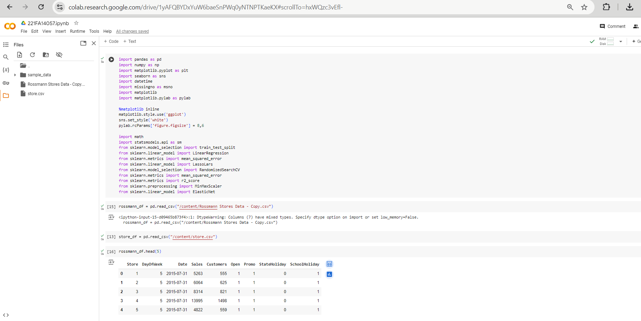

Linear Regression in Python

Slide 6
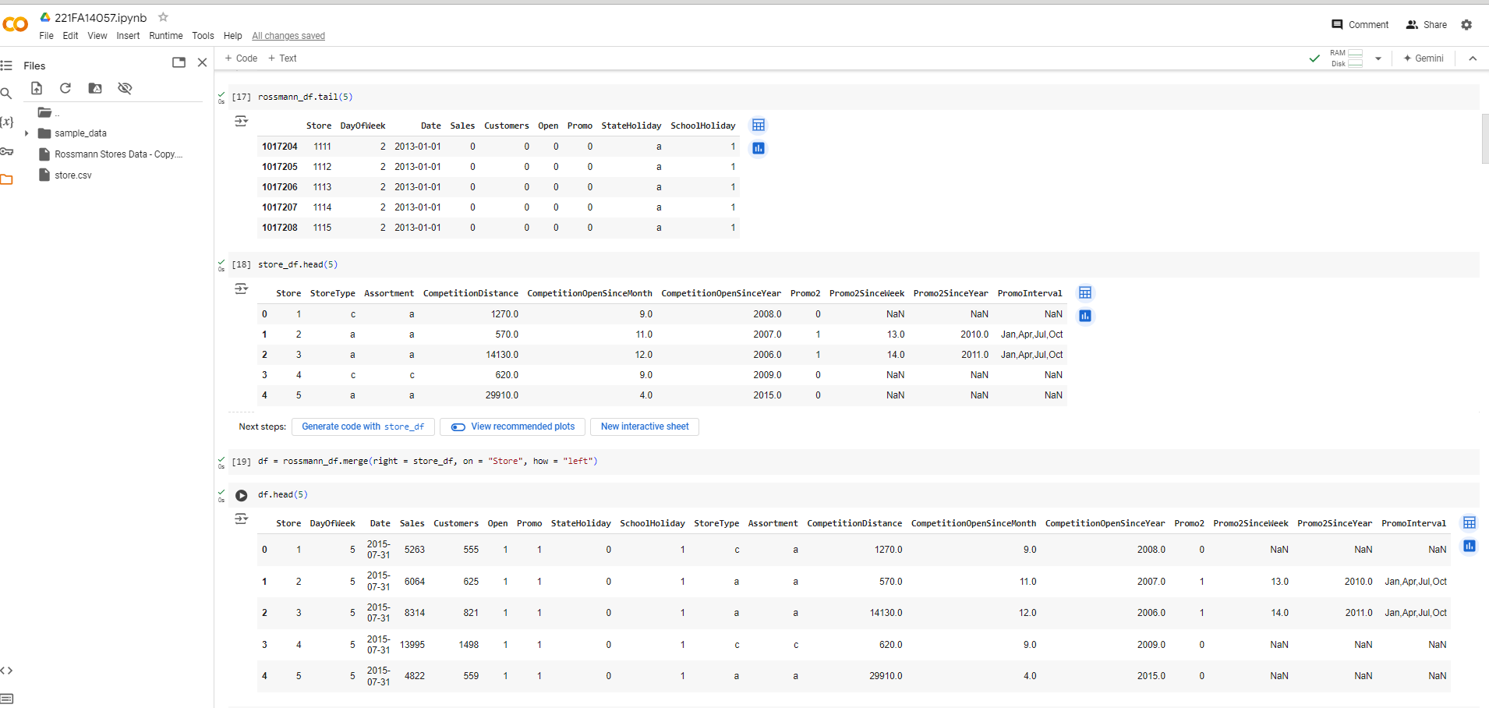
Linear Regression in Python

Slide 7
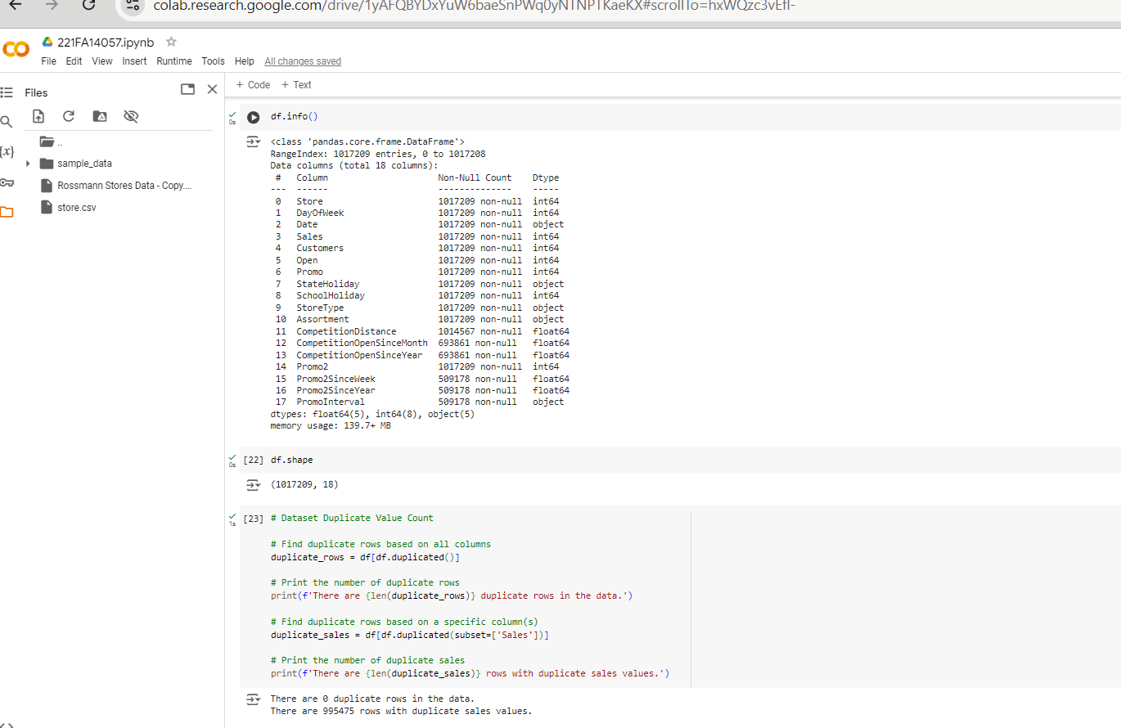
Linear Regression in Python

Slide 8
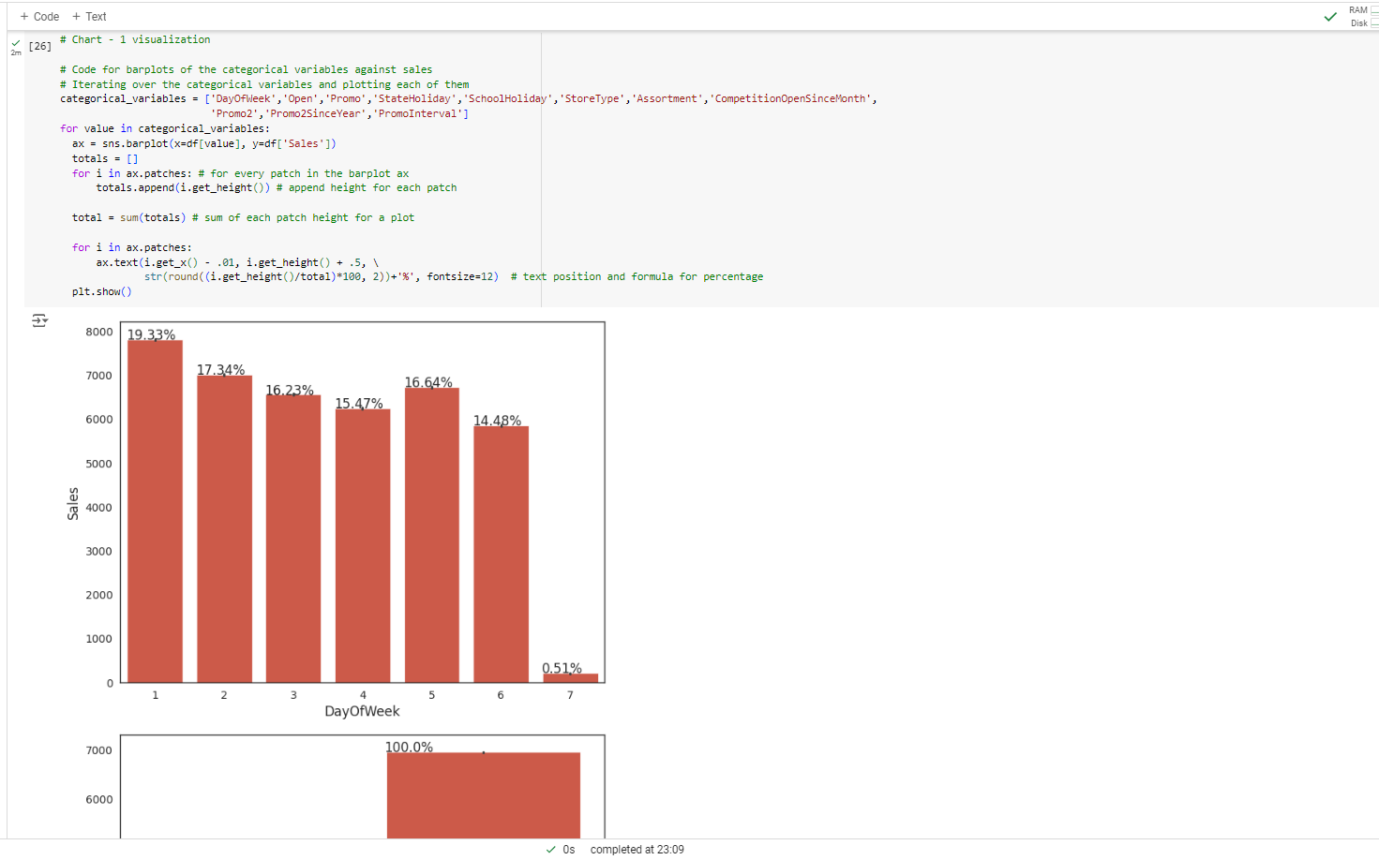
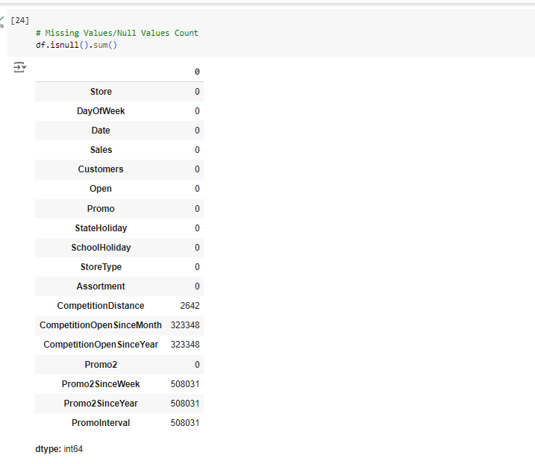
Linear Regression in Python

Slide 9
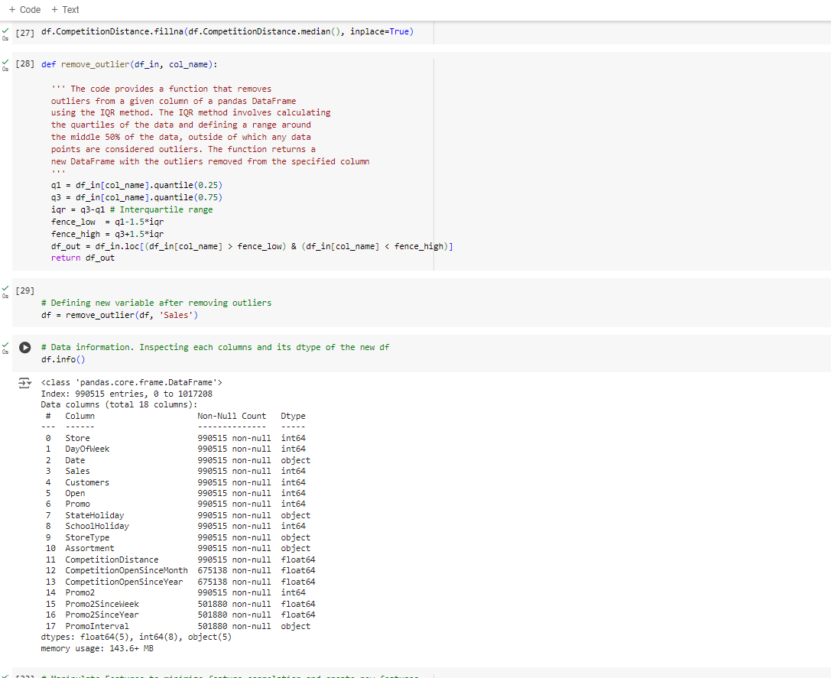
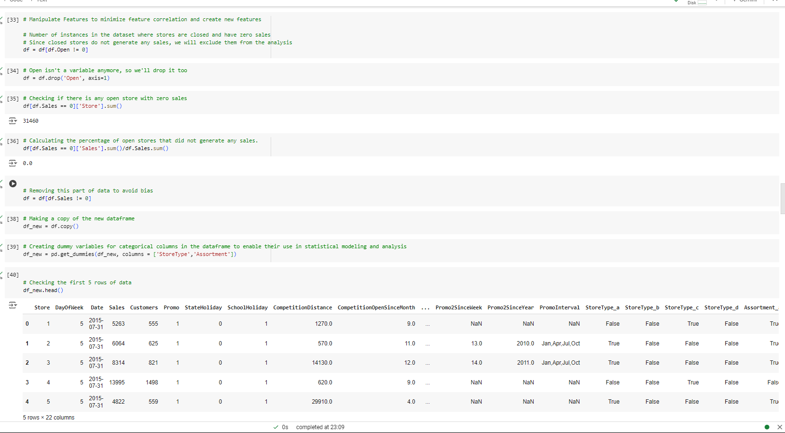
Linear Regression in Python

Slide 10
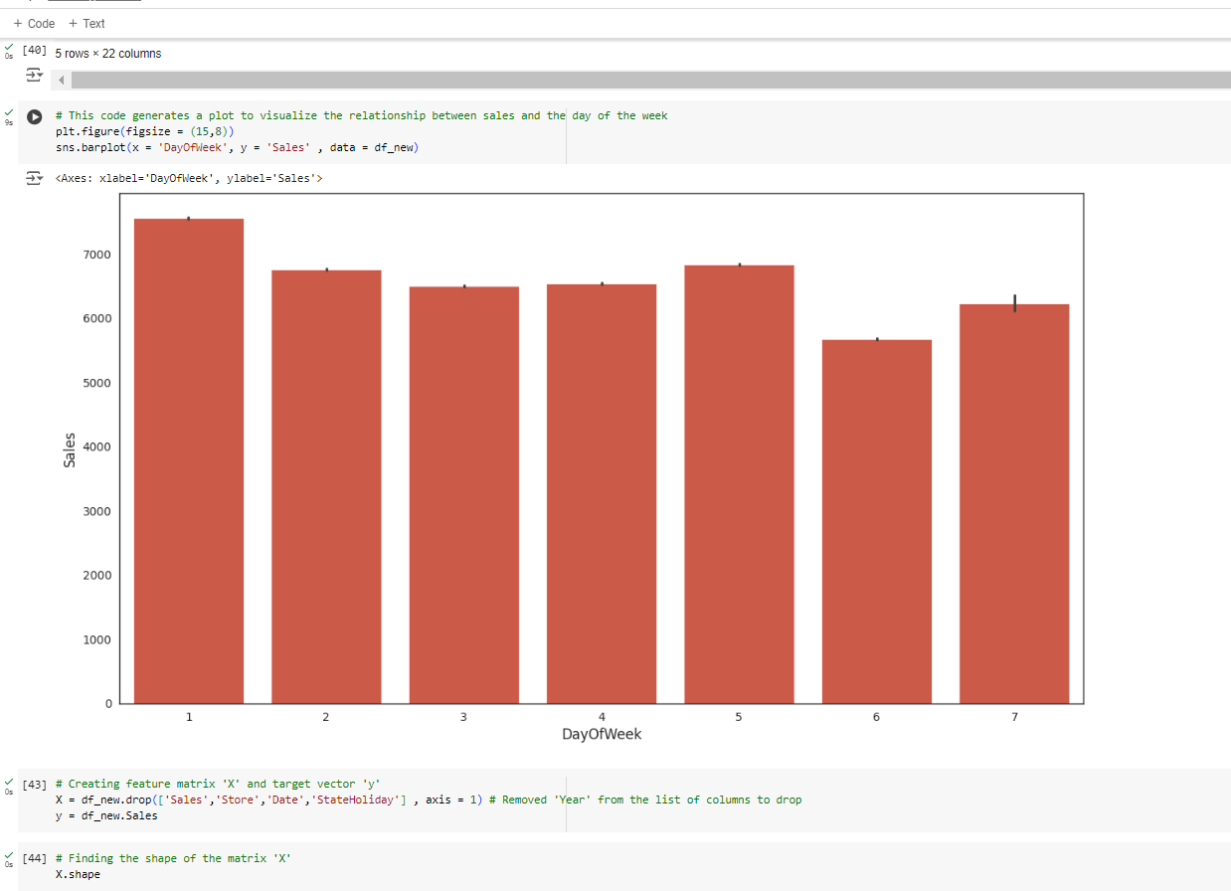
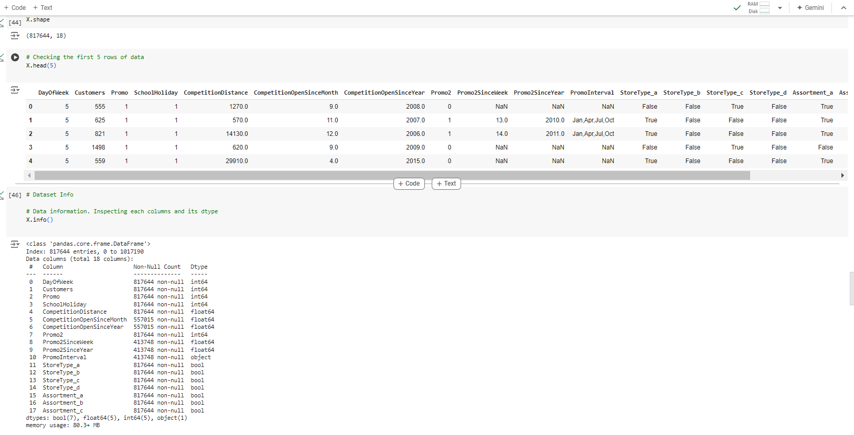
Linear Regression in Python

Slide 11
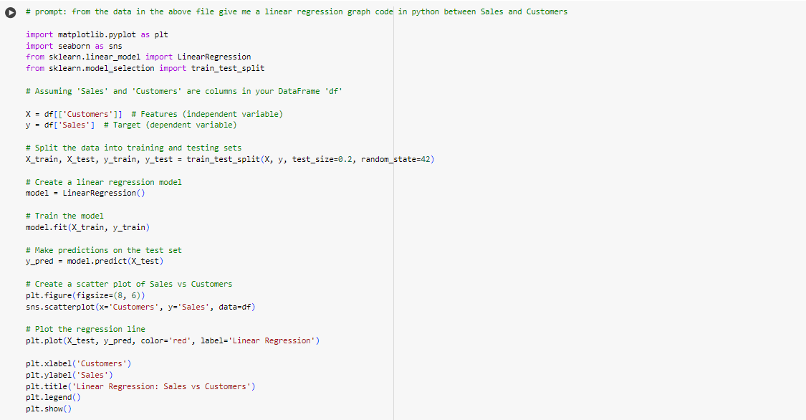
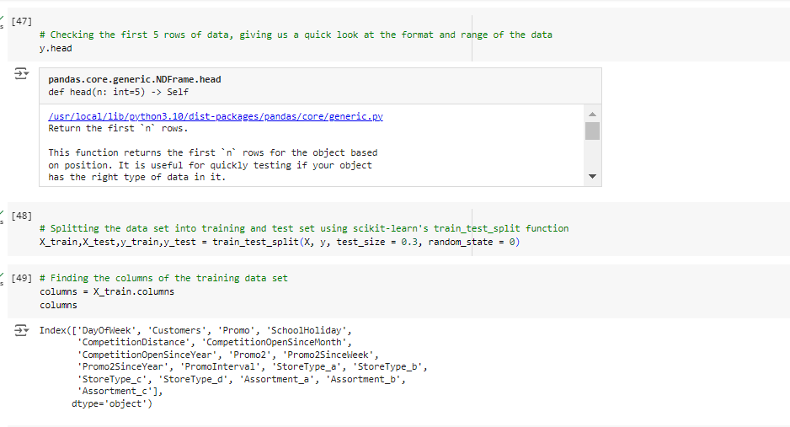
Linear Regression in Python

Slide 12
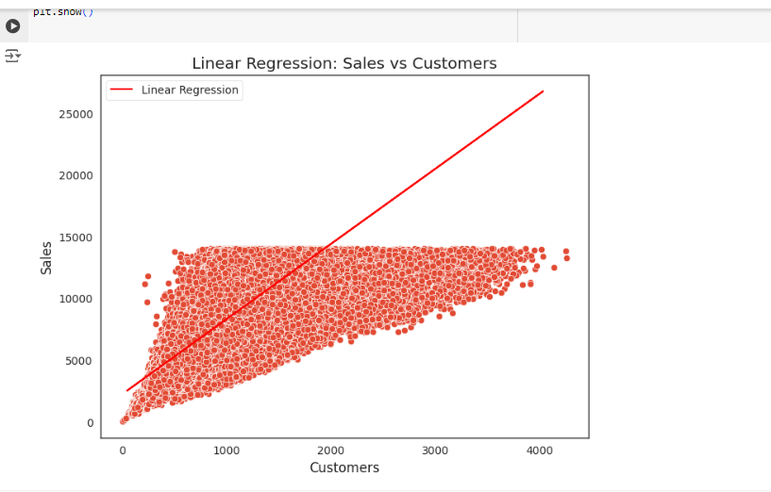
Linear Regression in Python result

Slide 13
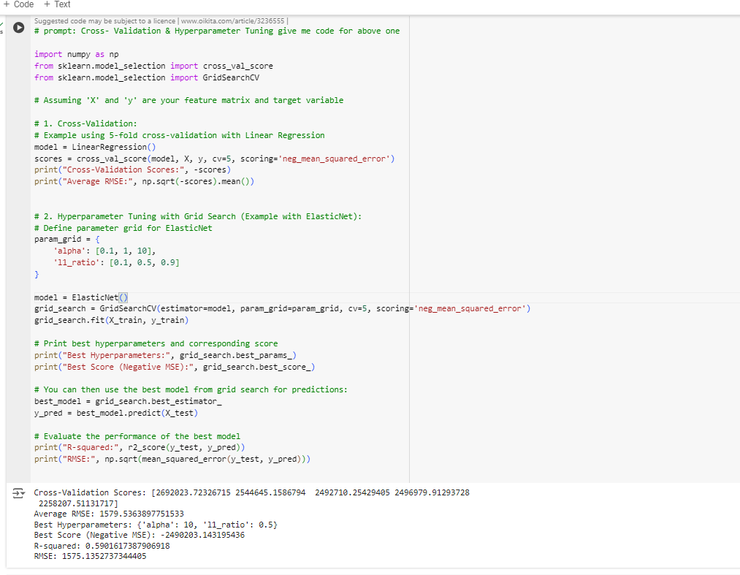
Linear Regression in Python

Slide 14
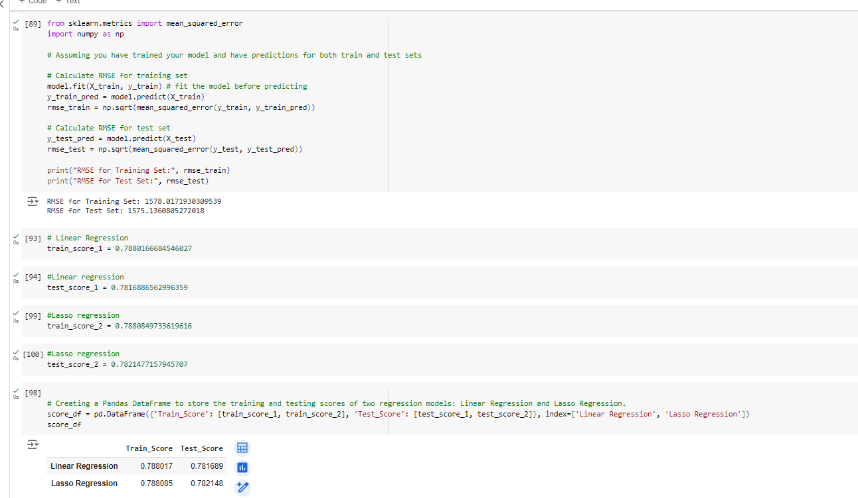
Linear Regression in Python comparison

Slide 15
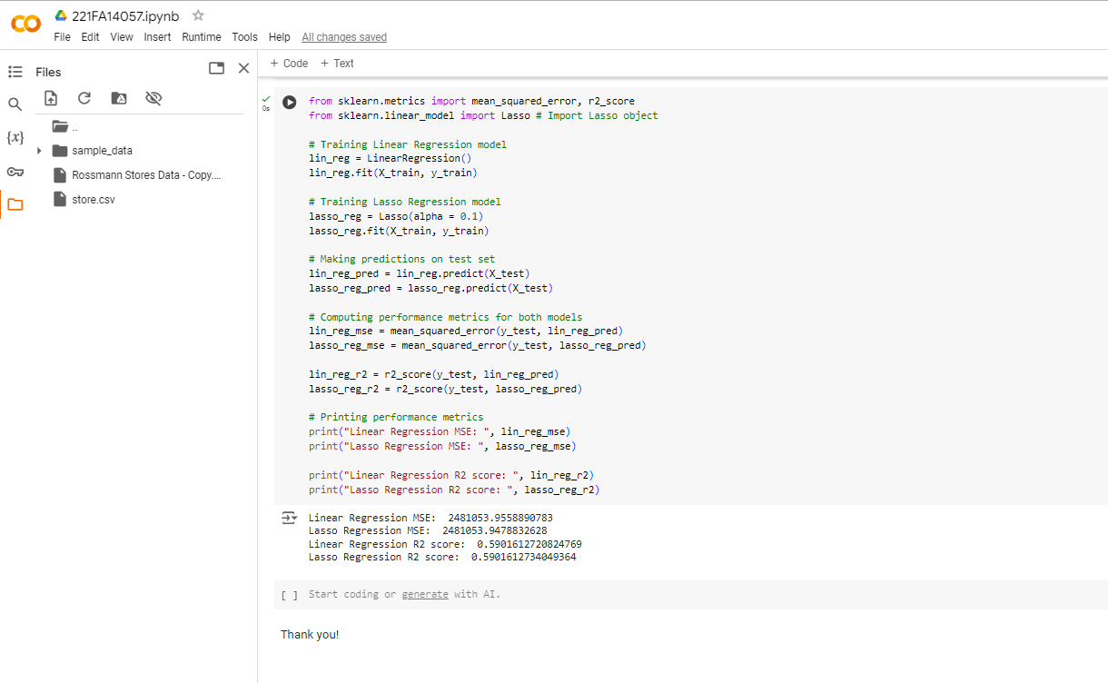
Linear Regression in Python and its R square values

Slide 16
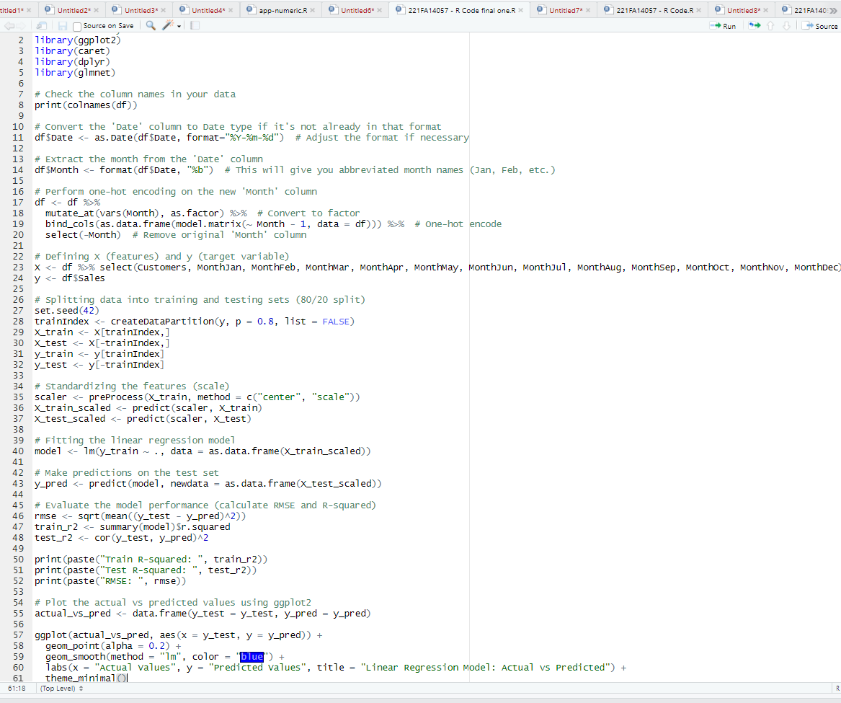
Linear Regression in R and its R

Slide 17
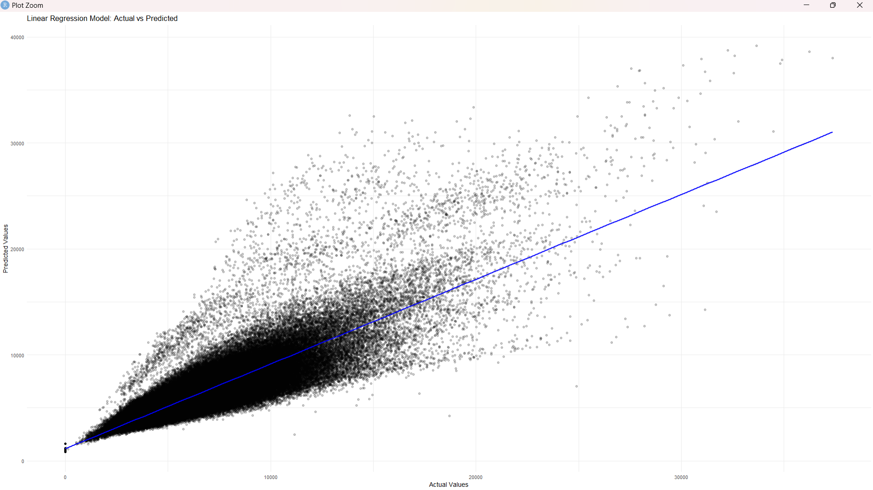
Linear Regression in R and its output

Slide 18


Conclusion
In predicting retail sales using linear regression, both Python and R offer robust methodologies with distinct tools. Python utilizes libraries like scikit-learn for model building and matplotlib for visualization, allowing the implementation of linear regression with functions to split data into training and test sets, and evaluate performance through metrics such as R-squared and Root Mean Squared Error (RMSE). In contrast, R employs the lm() function for linear regression, complemented by ggplot2 for visualization, and provides detailed diagnostics through summary statistics. R also supports data splitting into training and test sets, and performance evaluation using metrics like R-squared and RMSE. Python's ecosystem excels in integration and handling large datasets, while R offers in-depth statistical analysis and rich visualization capabilities. The ultimate aim is to predict the R-squared value in a linear regression model, showcasing the effectiveness of machine learning techniques in R language.

Slide 19

THANK
M. Jagadeesh​
221FA14057
Bioinformatics – 3 A
You

